Slide 1

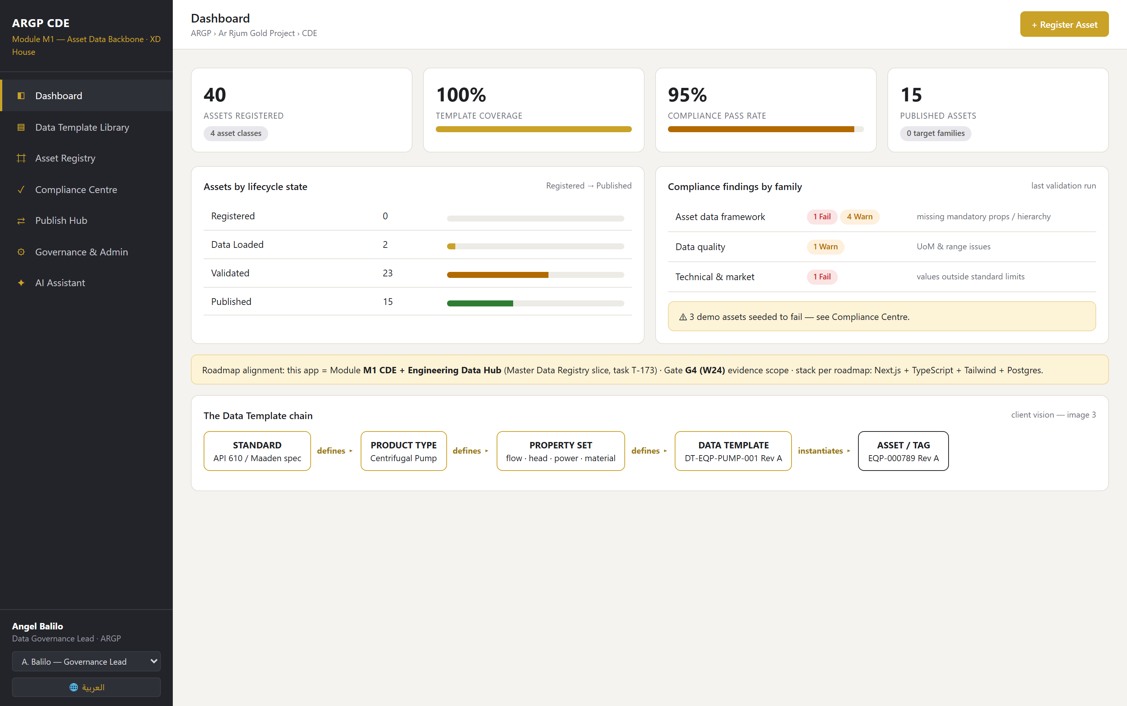
Your vision, running.
Ma'aden Ar Rjum Gold Project: CDE Asset Data Backbone
Module M1, Master Data Registry and Data Template governance. Built, seeded and demonstrable today. Every screen in this deck is the running application.
40
8
8
10
asset tags
templates
standards
integrations
SoW ARGP-DIGI-APP-SOW-001 Rev 00, task T-173, Gate G4 scope | 15 July 2026
Notes:
Open on this: it is not a mockup, it is running on a database. Everything in this deck is a screenshot of the live app, and you can click any of it.

Slide 2
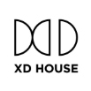
Your four diagrams, one system
You described the asset data backbone. This is that description, built.
YOUR DIAGRAM
WHAT IT SAYS
WHAT IS RUNNING
Data requirements chain
Standard defines Product Type defines Property Set defines Data Template.
Data Template Library: 8 templates, 24 properties, each derived from a named standard.
Governance and compliance
Three governance inputs feed three compliance checks before a template is applied.
Compliance Centre: 10 rules across the three families, run on demand.
Asset standards to CDE
Four asset classes with governed IDs and revisions, published downstream.
Asset Registry: 40 tags across STR, ELE, EQP and MAT, with revisions and lifecycle.
The CDE hub
The CDE at the centre of six system families.
Publish Hub: the 10 roadmap integrations, with payloads and hashes.
Nothing here is a mockup. It runs on PostgreSQL, on the stack the Master Roadmap specifies.
XD House | Ma'aden ARGP CDE Asset Data Backbone | 15 July 2026

Slide 3
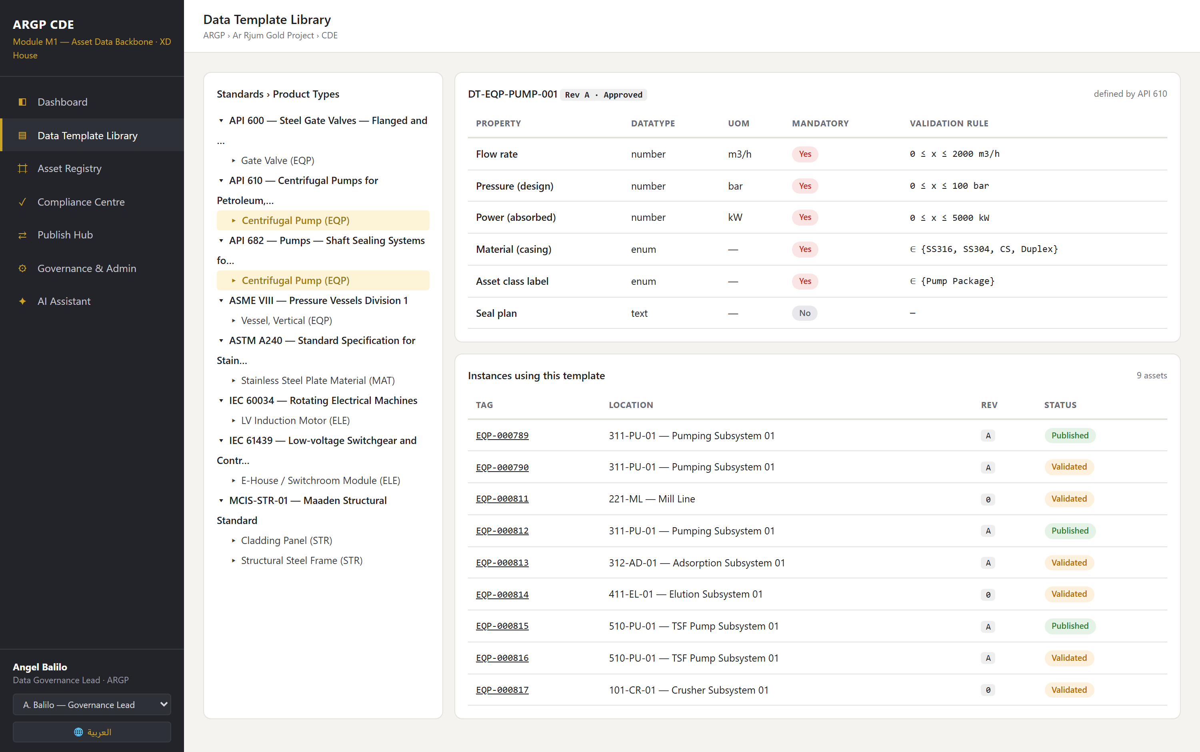
The Data Template chain, enforced
Standard defines Product Type defines Property Set defines Data Template
Your common digital language
✓
8 templates, each derived from a named standard: API 610, ASME VIII, ASTM A240, IEC 61439, IEC 60034, API 600, Maaden MCIS.
✓
Each property carries its unit, whether it is mandatory, and the rule that validates it.
✓
The template is a governed contract with its own revision and Draft to Review to Approved workflow.
✓
Every instance using the template is listed, so you can see what a change would touch.
This screen is your vision image 3, running.
XD House | Ma'aden ARGP CDE Asset Data Backbone | 15 July 2026

Slide 4
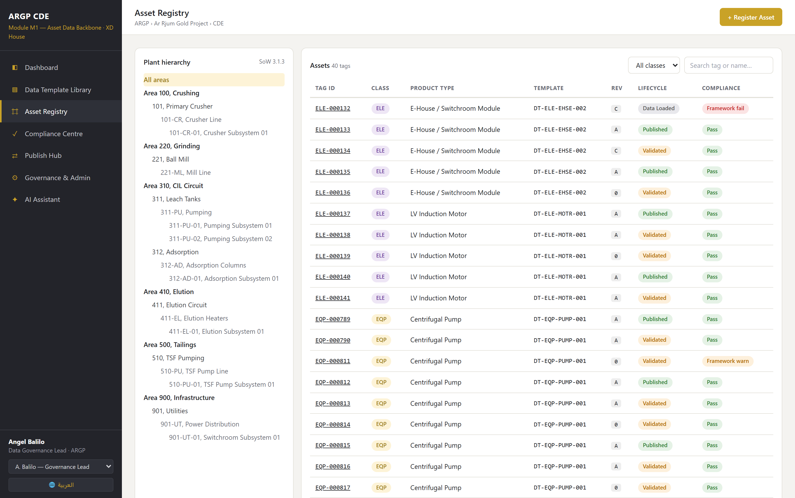
The registry: 40 governed tags
Area, Unit, System, Subsystem, per SoW 3.1.3. Seeded to the ARGP gold plant.
The MEL and Tag Register
✓
40 tags: 17 EQP, 10 ELE, 8 STR, 5 MAT. Pumps, vessels, valves, E-Houses, motors, frames, cladding, plate.
✓
27 hierarchy nodes across 6 areas: Crushing, Grinding, CIL, Elution, Tailings, Infrastructure.
✓
Tag format, revision and lifecycle follow your conventions exactly.
✓
Filter by class, search by tag or name, drill into any node of the tree.
This is task T-173 in the Master Roadmap, working.
XD House | Ma'aden ARGP CDE Asset Data Backbone | 15 July 2026

Slide 5
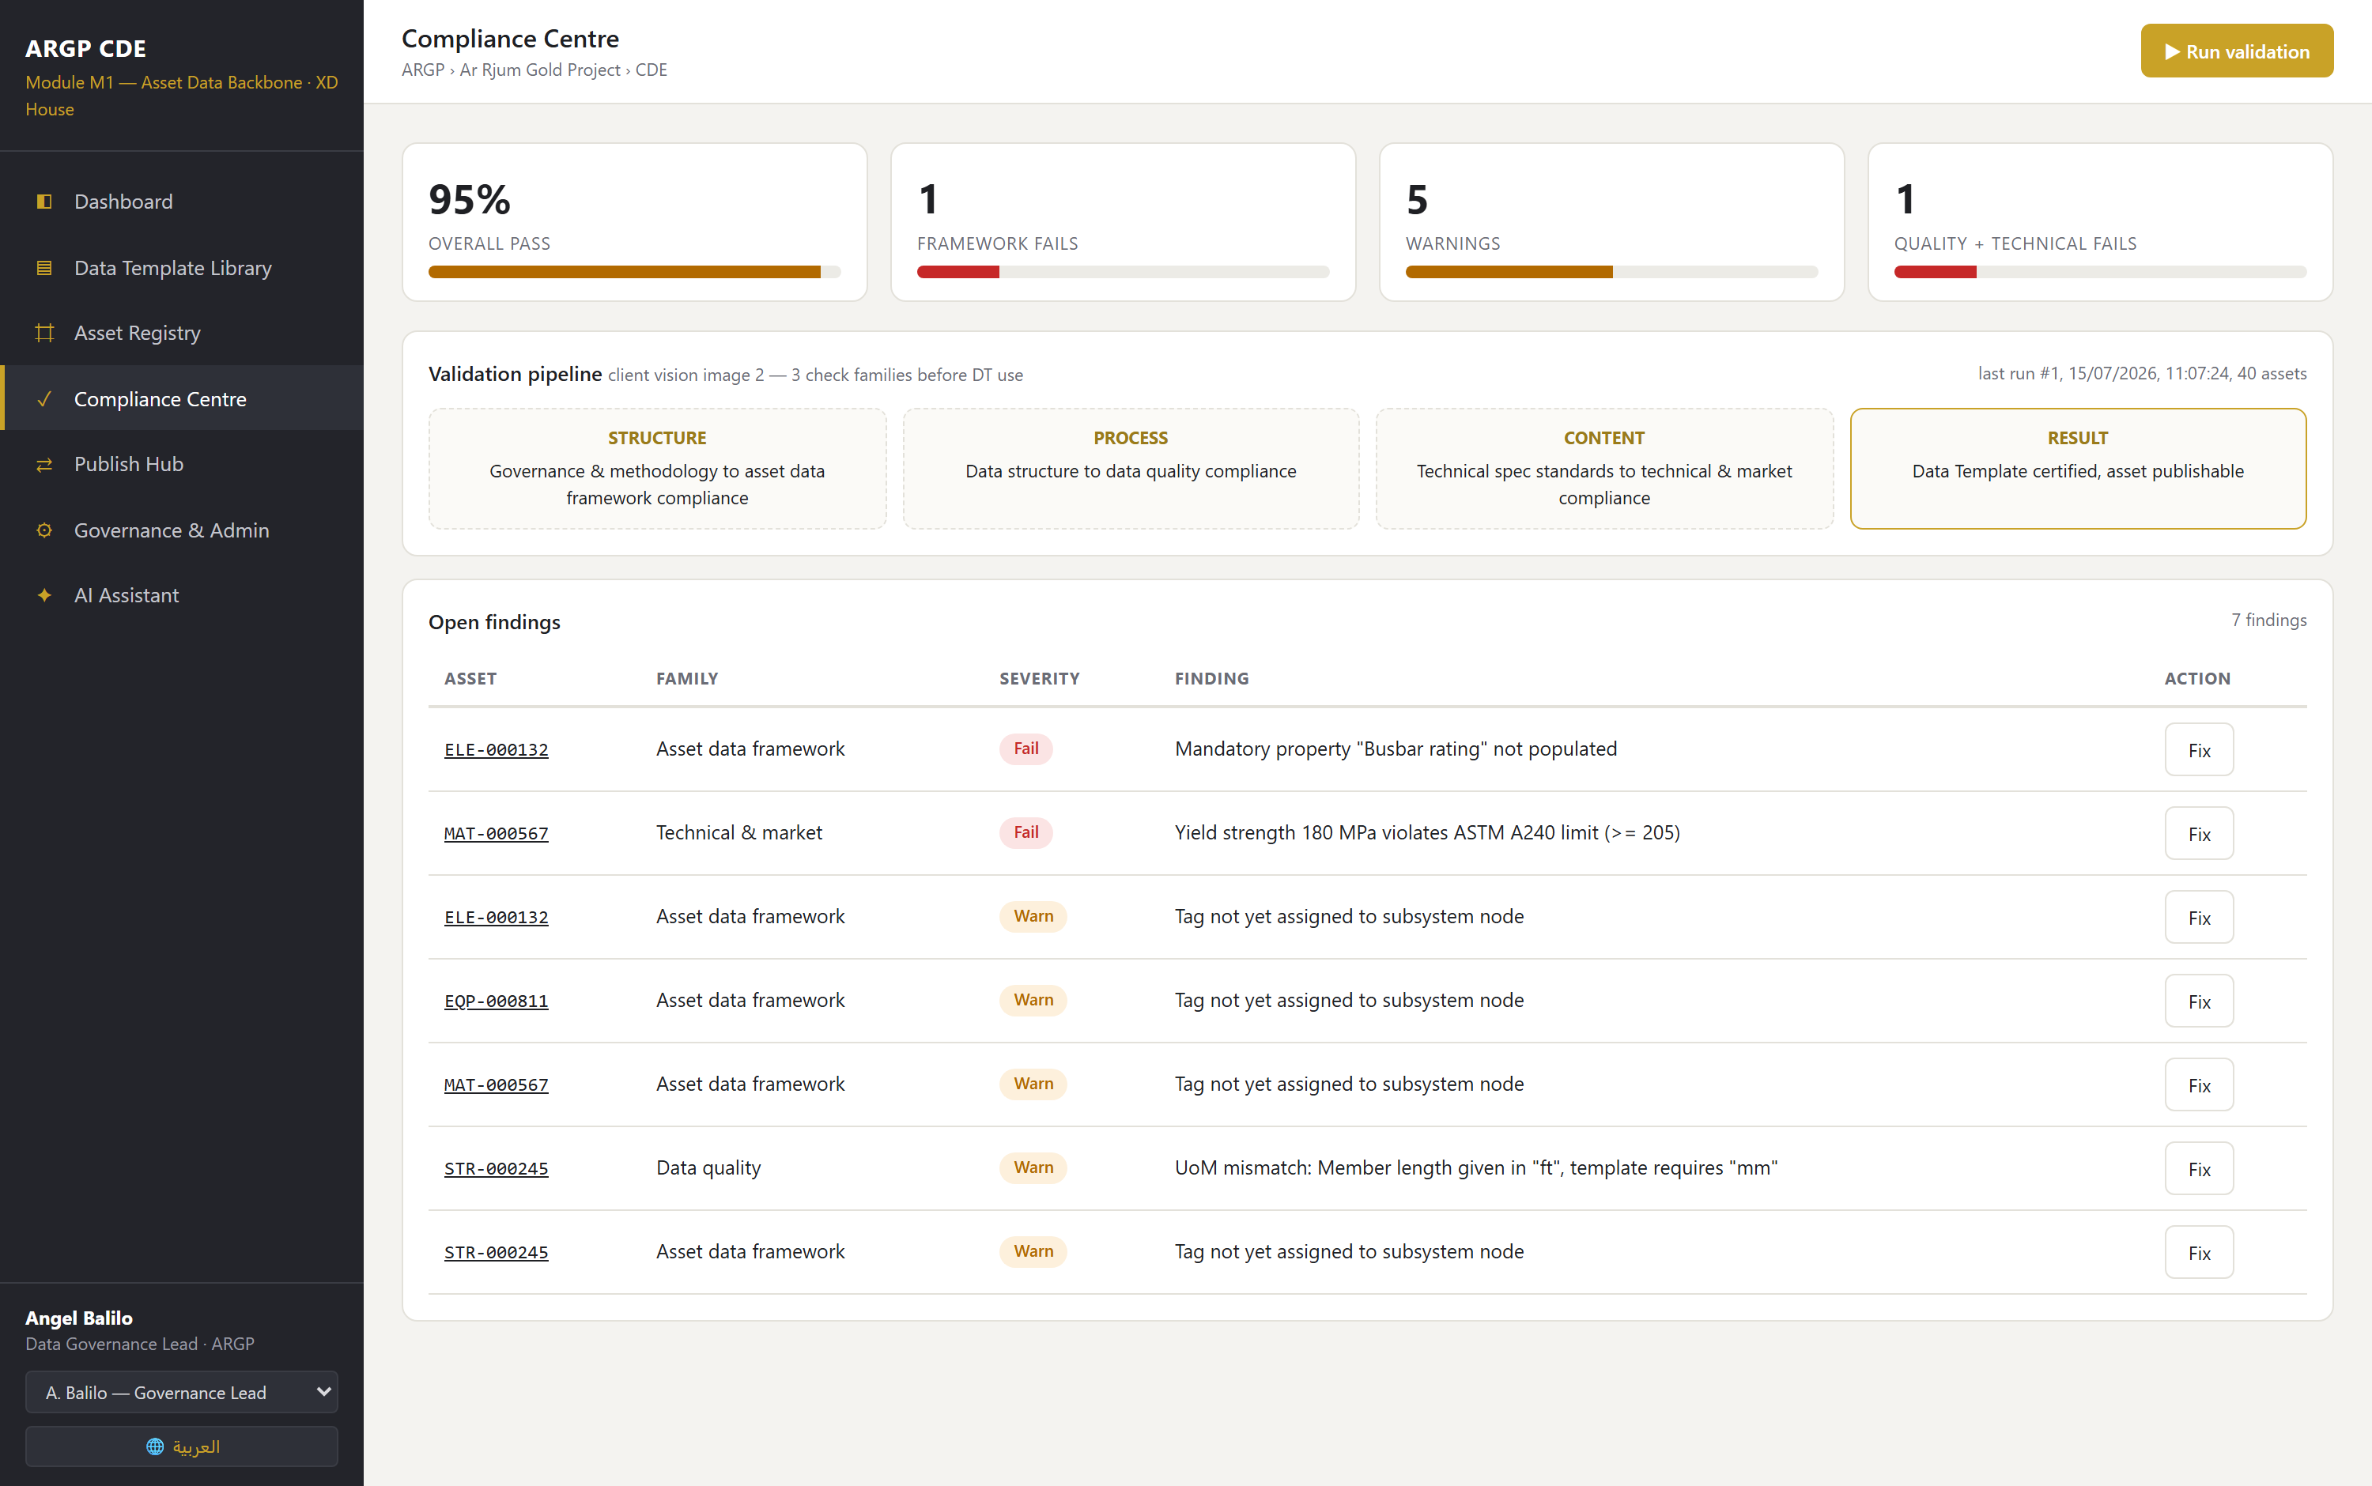
Governance enforced before publication
Your diagram: three governance inputs, three compliance checks, then the template applies
Three check families
✓
STRUCTURE, the asset data framework: mandatory properties, template, hierarchy, tag format.
✓
PROCESS, data quality: unit of measure, datatype, ranges, duplicate tags.
✓
CONTENT, technical and market: values against the standard's own limits.
✓
A run writes an immutable record of what was checked and what failed. Each finding links to the fix.
The rule that stops a plate shipping cites ASTM A240 and the minimum it requires.
XD House | Ma'aden ARGP CDE Asset Data Backbone | 15 July 2026

Slide 6
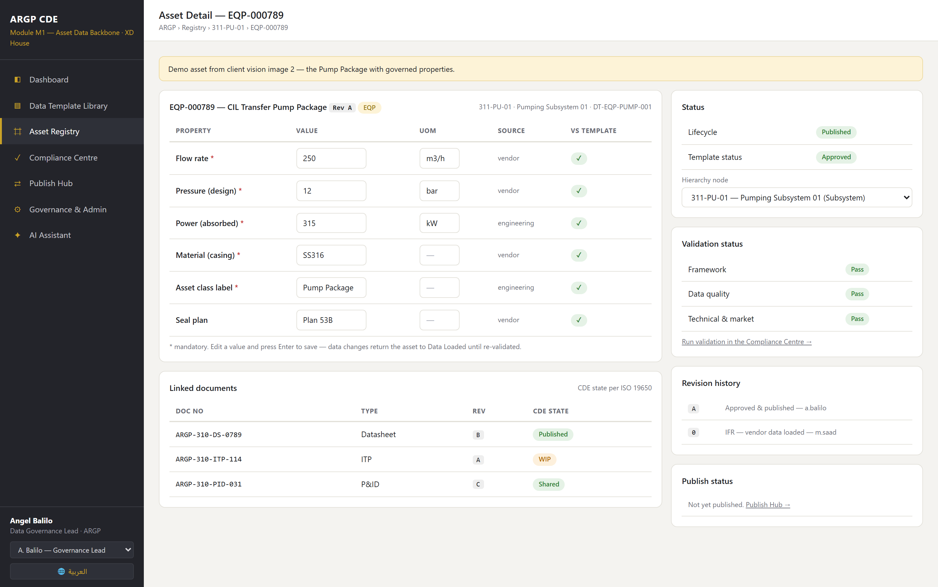
Your own example, end to end
EQP-000789, the pump package from your governance diagram
The ten minute demo
1
Run validation
40 assets checked. Three fail, each in a different family.
2
Three causes
A missing mandatory property. A length in feet where the template demands millimetres. A yield strength below the ASTM A240 minimum.
3
Fix them live
Every change records who, what, from what, to what, and when.
4
Re-validate, publish
Zero failures. EQP-000789 goes out with a hashed payload.
The dashboard goes green in front of you.
XD House | Ma'aden ARGP CDE Asset Data Backbone | 15 July 2026
Notes:
Run this live rather than talking about it. The three seeded failures are deliberate and each fails for a different reason.

Slide 7
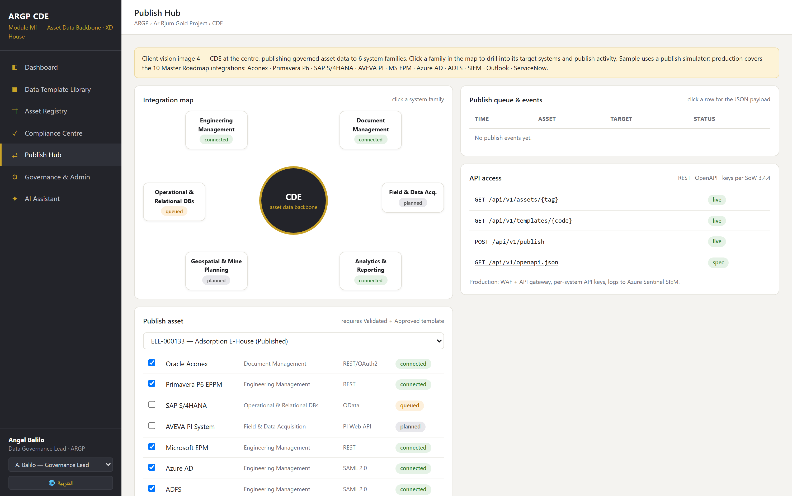
Publishing to your systems
The CDE at the centre, per your fourth diagram. Governed data out, provably.
Gated, and provable
✓
The 10 roadmap integrations, mapped across your six system families. Click a family to drill in.
✓
An asset publishes only when it is Validated against an Approved template. Non-compliant assets are blocked, and the block is recorded.
✓
Every publish stores the full payload and a sha256 hash, so what went to Aconex, P6 or SAP can be proven later.
✓
Geospatial has no system named among the roadmap's ten, so it shows as planned rather than claimed.
In the sample this is a simulator. Production swaps it for the Middleware connectors.
XD House | Ma'aden ARGP CDE Asset Data Backbone | 15 July 2026
Notes:
Say plainly that publishing is simulated in the sample. It writes a payload row rather than calling Aconex. Do not oversell it in the room.

Slide 8
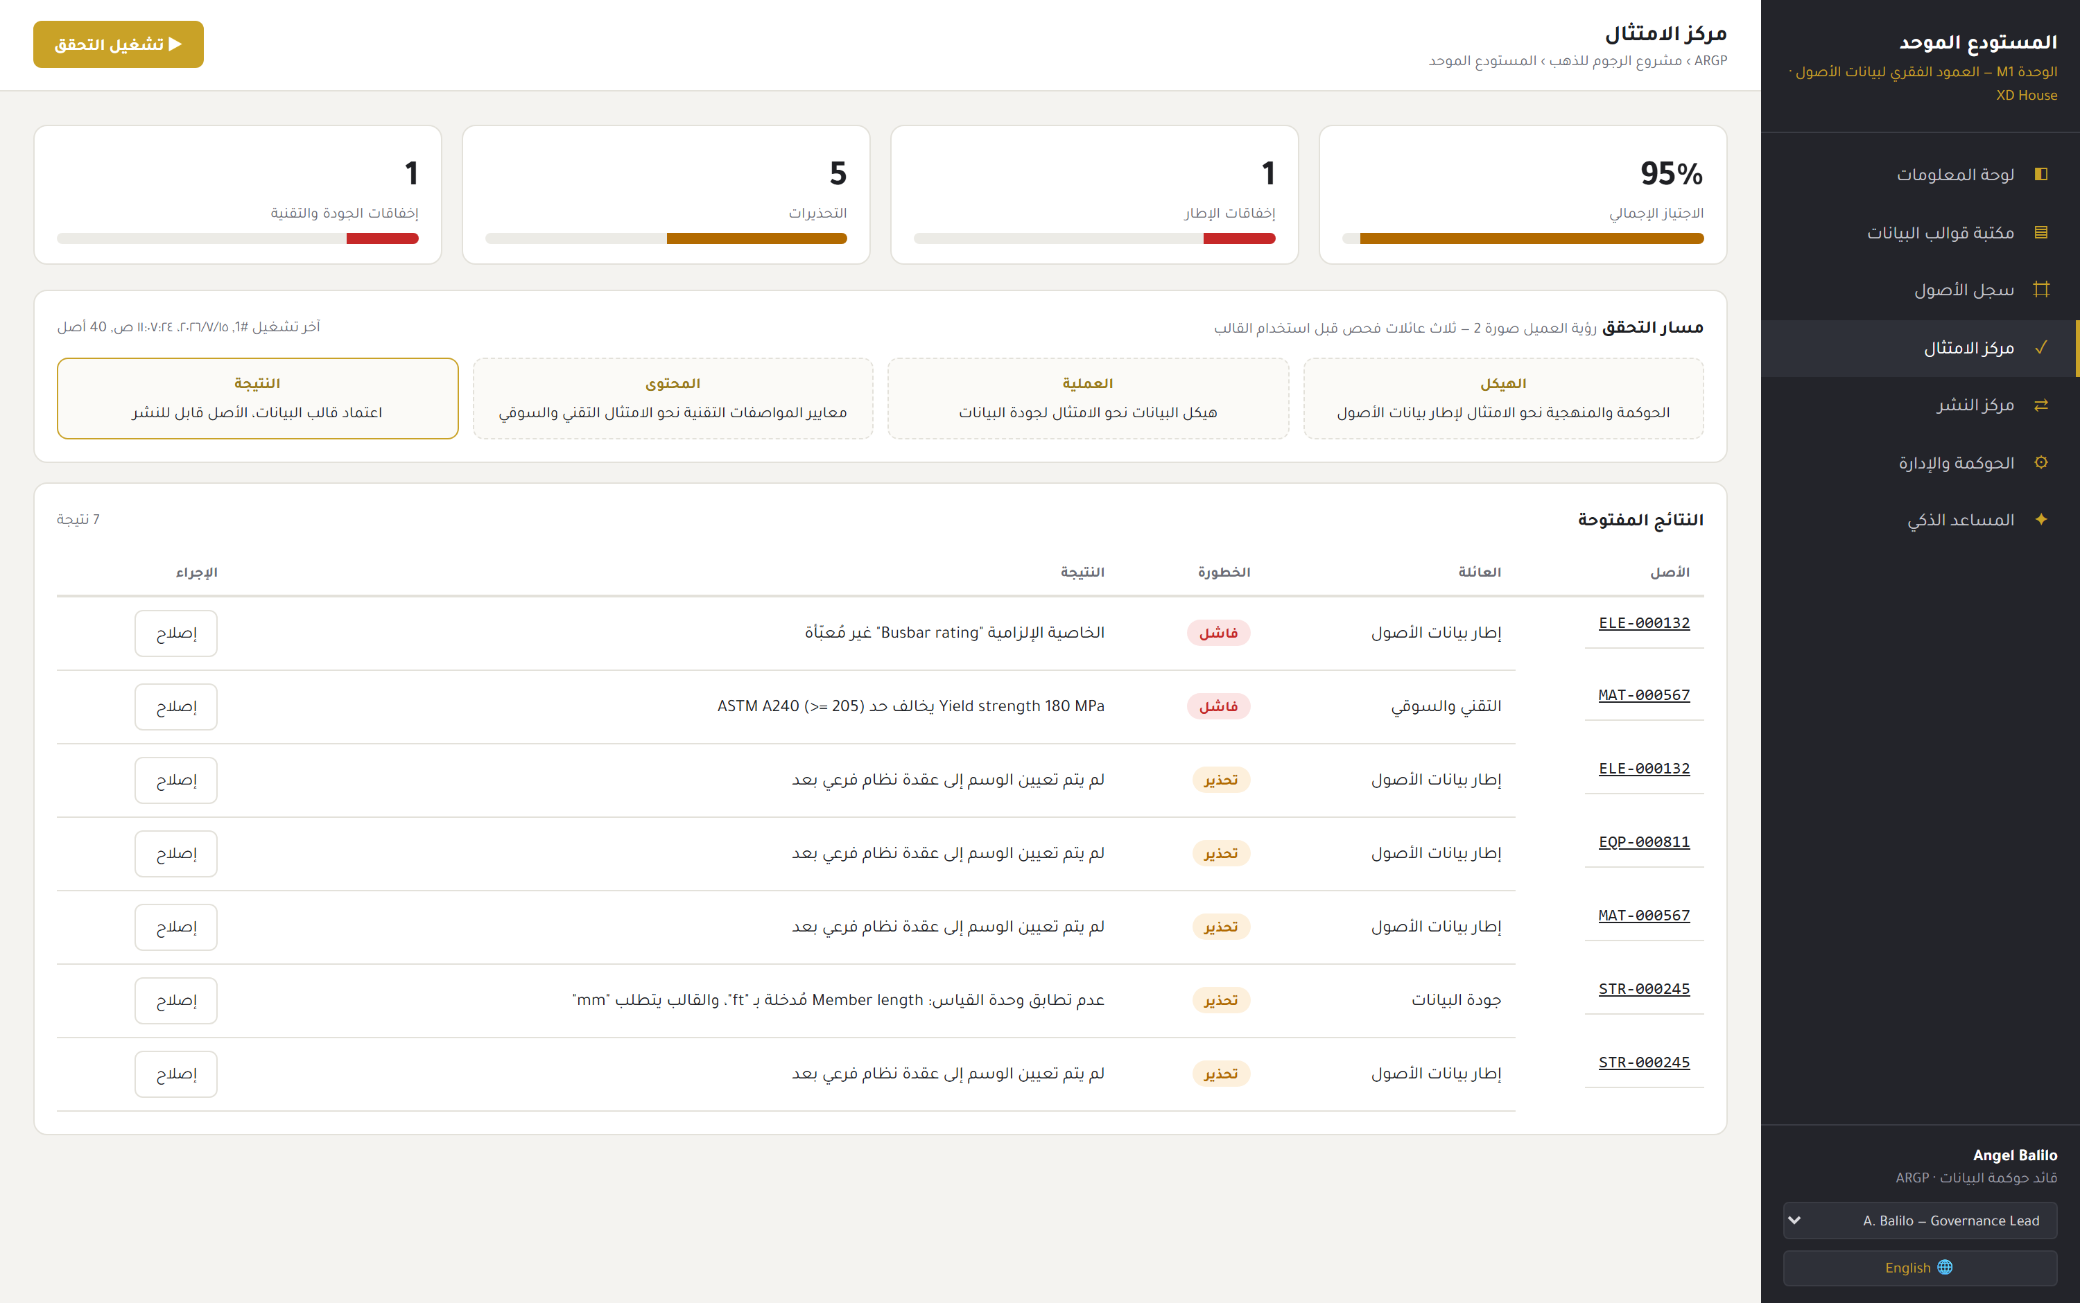
Built for the Kingdom, in Arabic
The same screen, one click away. Full right to left layout, not a translated afterthought.
Arabic, right to left
✓
The whole interface mirrors: navigation moves right, tables and the hierarchy tree re-lay out.
✓
Typeset in Tajawal, loaded and self-hosted rather than pulled from a public CDN at runtime.
✓
Findings are stored as a key plus data, never as English prose, so one record renders in either language.
✓
Tag IDs, standard codes and property names stay as they are, because that is how your engineers reference them.
Dates and numerals localise too. The screen behind is the same run, in Arabic.
XD House | Ma'aden ARGP CDE Asset Data Backbone | 15 July 2026

Slide 9
What this proves
✓
We understood the brief
Your four diagrams describe one governed backbone. We built exactly that, down to your own pump.
✓
We can build it on your stack
Next.js, TypeScript, PostgreSQL, Azure-ready and KSA-resident. This is M1 and Gate G4 scope, working.
✓
The backbone comes first
M2 work packages, M3 checksheets, M4 ITPs and M5 procurement all consume tags, hierarchy and templates.
Our recommendation. The roadmap builds M1 in Phase 4a, yet the M2 and M3 pilots in weeks 5 to 12 already consume tags, hierarchy and templates. Pull the Master Data Registry core forward into Phase 1 and 2 as a foundation service. This demo is the evidence that it can be done.
XD House | Ma'aden Ar Rjum Gold Project | 15 July 2026
Notes:
Close on the sequencing recommendation. It is the commercially useful point: the registry is a dependency for the pilot modules, so building it first de-risks the programme.

